Slide 1

PRESENTATION TITLE
SECURE STORAGE USING HYBRID CRYPTOGRAPHY
Mirjam Nilsson​

Slide 2
TEAM MEMBERS
GHANSHYAM GADEKAR (AI 18)
SHRUTI KAMBALI (AI 29)
POORVA PADAVE (AI 43)
POORVA PATIL (AI 49)

Slide 3
Introduction
Accessing data from any location.
The stored type of file is completely secured.
This prevents data leak if a breach occurred.

Slide 4
PROPOSED SYSTEM
The system will help user to secure data using different encryption algorithm .
User can upload passwords as well as text files.
The user with the proper key will be able to access the particular file.

Slide 5
PROJECT PRE-REQUISITES
HARDWARE REQUIREMENTS
SOFTWARE REQUIREMENTS
Computer/laptop
Intel i3 6th Gen or higher/4gb Ram
Python
Flask
HTML
CSS
JavaScript

Slide 6
PROJECT OVERFLOW

Slide 7
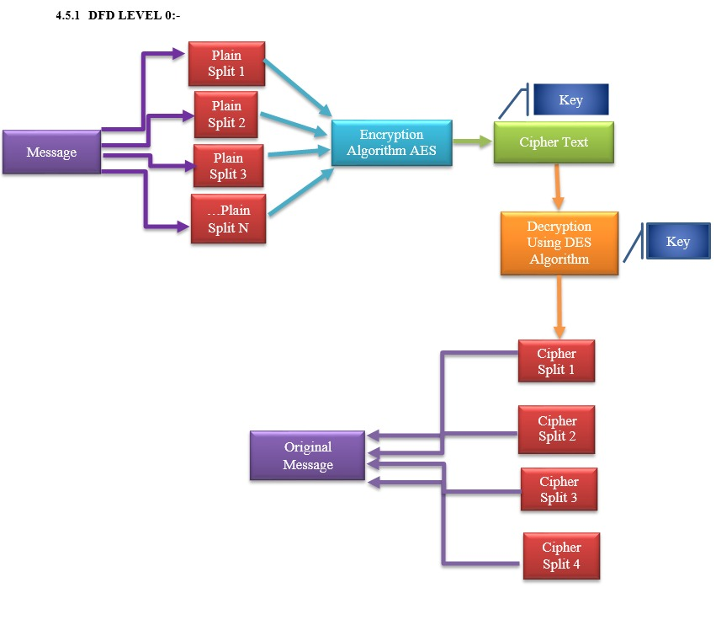

Slide 8
Flow of system
ENCRYPT
UPLOAD FILE
ENCRYPTION SUCCESSFUL
DOWNLOAD KEY
START
SELECT
BACK HOME
STOP
RESTORE
DOWNLOAD FILE
UPLOAD KEY
DECRYPTION SUCCESSFUL

Slide 9
PURPOSE
A system which stores data after encryption.
This prevents data leak if a breach occurred.
Any form of data can be stored.
It ensures data confidentiality to users.
”

Slide 10
ALGORITHMS USED
AES
BLOWFISH ALGORITHM
DES
ADVANCED ENCRYPTION ALGORITHM
DATA ENCRYPTION ALGORITHM

Slide 11
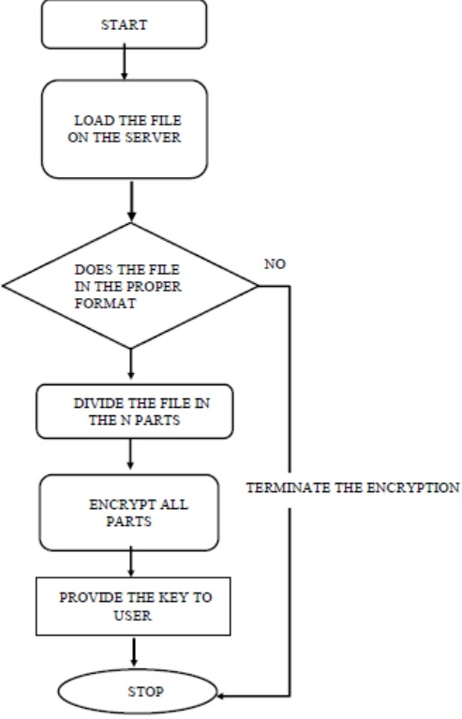
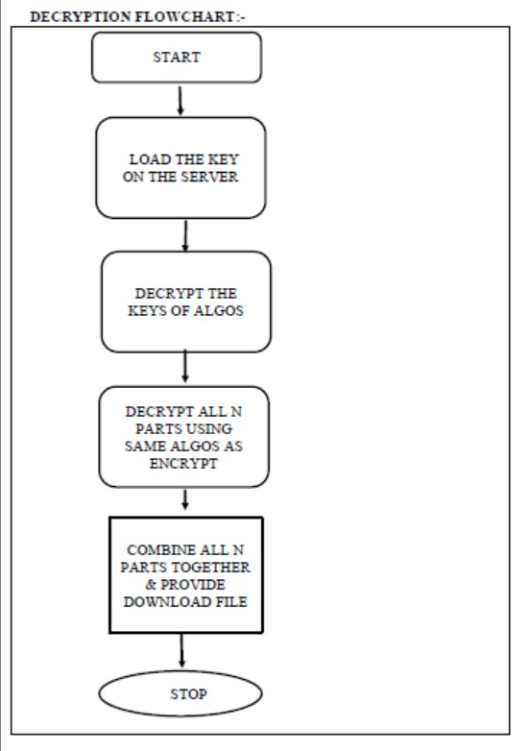
AES
DES
DIFFERENCE IN WORKFLOW OF AES AND DES

Slide 12
STEPS FOR encryption
USER SELECTS FILE
ENCRYPT USING AES DES
GENERATE KEY
SEARCH FILE
VIEW FILE AND SEND REQUEST
ENTER KEY
ENCRYPT USING KEY
DOWNLOAD FILE

Slide 13
SYSTEM ARCHITECTURE

Slide 14
USER
USER PASSWORD AUTHENTICATION
UPLOAD FILE
REQUEST FILE FOR DOWNLOAD
SPLIT FILES AND ENCRYPT EACH FILE
DECRYPT AND COMBINE THE FILES
CLOUD SERVER
CLOUD SERVER NOD 1
CLOUD SERVER NOD 2
CLOUD SERVER NODE 3

Slide 15
Components of system
Encryption and Decryption
Key Management
Storage and Retrieval
Access Control

Slide 16



Future Scope
advancements in artificial intelligence and machine learning
E-commerce Security
Blockchain & CLOUD Security

Slide 17
CONCLUSION
This project implements a double stage encryption algorithm that provides high security, scalability, confidentiality and the easy accessibility of multimedia content in the cloud.
The proposed algorithm is crucial in the second stage, the randomly generated key provides more security than the conventional encryption system.
The ciphertext is stored in the cloud instead of original multimedia content.
Thus, the multimedia content is safe in the cloud.

Slide 18
THANK YOU

